Slide 1
A new tree inclusion algorithm
Yangjun Chen , Yibin Chen
Information Processing Letters 98 (2006) 253–262
Presenter： Shiuan-Wen Chen
Date： May 11, 2006

Slide 2
Abstract
We consider the following tree-matching problem: Given labeled, ordered trees P and T , can P be obtained from T by deleting nodes? Deleting a node v entails removing all edges incident to v and, if v has a parent u, replacing the edges from u to v by edges from u to the children of v. The existing algorithm for this problem needs O(|T ||leaves(P )|) time and O(|leaves(P )|min{D_{T} , |leaves(T )|}) space, where leaves(P ) (leaves(T )) stands for the number of the leaves of P(T ), and D_{T} for the height of T . In this paper, we present a new algorithm that requires O(|T |min{D_{P} , |leaves(P )|}) time and no extra space,where D_{P} represents the height of P.

Slide 3
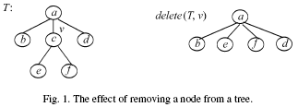
1. Introduction
Can we obtain pattern P by deleting some nodes from target T ? That is, is there a sequence v₁, . . . , v_{k} of nodes such that for
T₀ = T and
T_{i+1} = delete(T_{i}, v_{i+1}) for i = 0, . . . , k −1, we have T_{k} = P .
Such a problem is called the tree inclusion problem.

Slide 4
1. Introduction
The ordered tree inclusion problem was initially introduced by Knuth [5]
The tree inclusion has been suggested as an important primitive for expressing queries on structured document databases [3].
Kilpelainen and Mannila [4] presented the first polynomial time algorithm using O(|T|·|P|) time and space.
In [2], a more complex algorithm was presented using O(|T| · |leaves(P)|) time and O(|leaves(P)| · min{D_{T} , |leaves(T)|}) space.

Slide 5
1. Introduction
All the above algorithms work in a bottom-up way.
we propose a new algorithm by integrating a top-down process into a bottom-up computation.
It needs only O(|T| · min{D_{P} , |leaves(P)|}) time and no extra space, where D_{P} represents the height of P .

Slide 6
2. Orderings and embeddings
Lemma 1. Let v and u be nodes in a forest F. Then, v is an ancestor of u if and only if pre(v) < pre(u) and
post(u) < post(v).
Lemma 2. Let v and u be nodes in a forest F. Then,
v appears on the left side of u if and only if pre(v) <
pre(u) and post(v) < post(u).
A
F
I
Preorder: ABECDFGHI
Postorder: EBCDGHIFA
B
C
D
G
H
E

Slide 7

2. Orderings and embeddings
Definition 1. Let F and G be labeled ordered forests.
We define an ordered embedding (φ,G,F) as an injective function φ :V (G)→V (F) such that for all nodes v,u ∈ V (G),
(i) label(v) = label(φ(v)) (label preservation condition);
(ii) v is an ancestor of u iff φ(v) is an ancestor of φ(u), i.e.,
pre(v) < pre(u) and post(u) < post(v) iff pre(φ(v)) <
pre(φ(u)) and post(φ(u)) < post(φ(v)) (ancestor condition);
(iii) v is to the left of u iff φ(v) is to the left of φ(u), i.e., pre(v)
< pre(u) and post(v) < post(u) iff pre(φ(v)) < pre(φ(u)) and
post(φ(v)) < post(φ(u)) (Sibling condition).

Slide 8

2. Orderings and embeddings
Definition 2. Let P and T be trees. A root-preserving embedding of P in T is an embedding φ of P in T such that φ(root(P )) = root(T ). If there is a root-preserving embedding of P in T , we say that the root of T is an occurrence of P .
Definition 3. Let G = P₁, . . . , P_{k} and F be a forests, and E be a collection of embeddings of G in F. An embedding φ∈ E is a left embedding of E if for everyγ∈ E, we have post(φ(root(P_{k}))) ≦ post(γ(root(P_{k}))).

Slide 9
3. Algorithm
The algorithm to be presented attempts to find the number of subtrees j (≧0) within an ordered forest G =P₁, . . . , P_{q} (q≧1), which are embedded in a target tree T .
There are three cases that need to be considered when designing an algorithm to check the tree embedding:

Slide 10
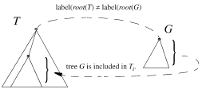
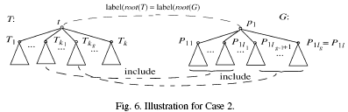
3. Algorithm
Case 1: root(G) ≠ p_{v} (i.e., G = <P₁> and root(G) = p₁), and label(p₁) ≠ label(t).
Case 2: root(G) = p_{v} (i.e., G = P₁ and root(G) = p₁), and label(p₁) = label(t).

Slide 11
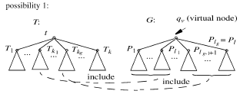
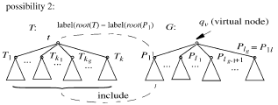
3. Algorithm
Case 3: root(G) = p_{v} and there exists an integer j
(0≦ j≦ q) such that P₁, . . . , P_{j} is included in T .

Slide 12
3. Algorithm
Trivial case: G contains only one single node p.
  Only Cases 1 and 2 to be encountered, encountered, and the problem can be easily solved using a preorder tree traversal starting at root(T).
G < P₁, . . . , P_{q} >(single nodes)
T (case 3)
it is simple to scan from
t₁ to t_{k} to find k₁, . . . , k_{s} and l₁, . . . , l_{s}
such that label(t_{ki} ) = label(p_{li} ).
t
t₁
….
t_{k}

Slide 13
3. Algorithm
G < P₁, . . . , P_{q} >(single nodes)
If the height of T is greater than two, a more complicated bottom-up process is required to handle Case 3.
T
Denote j_{return} the number of the subtrees
that are found in the tree rooted at t_{s} .
G_{s} = < P_{f}, . . . , P_{q} >
Step 1: search t_{s1} , if( j_{f}>0) G_{s} = < P_{jf+f}, . . . , P_{q} >
Step 2: search t_{s2}
until either all subtrees of t_{s} are traversed or G_{s} becomes empty.
j_{total} = j_{f} + j_{f+1} + ··· + j_{f+k−1} = 0
t
…
…
t_{s}
t_{s1}
…
t_{sk}
…
…
j_{f}個

Slide 14
3. Algorithm
Therefore, for G = < P₁, . . . , P_{q} >, which is a forest containing a list of single nodes, the result should be
if j_{total} > 0, j = f − 1+j_{return} = f − 1+j_{total}
else if label(p_{f} ) = label(t_{s} ),
j = f − 1+j_{return} = f − 1+1 = f
else j = f − 1+j_{return} = f − 1.

Slide 15
3. Algorithm
In the general Case 3
T
G
t_{s}
p_{v}
T₁
…
T_{k}
p₁
…
p_{q}
…
…
…
…
First check T₁, . . . , T_{k} against P₁, . . . , P_{q}
if the return value g>0, j=g
if g=0 , check label(p₁) against label(t_{s}) and T₁, . . . , T_{k} against the subtrees P₁₁, . . . , P_{1l} of p₁. It is exactly Case 2.(j=1)
Otherwise, j = 0.

Slide 16
3. Algorithm
In the general Case 2
We need to check T₁, . . . , T_{k} against P₁, . . . , P_{q} .
the control will be switched over to Case 3
Finally, we notice that Case 1 always ends up with
Case 2 unless the whole tree T is searched and no nodes are found matching p₁.
T
G
t_{s}
p
T₁
…
T_{k}
p₁
…
p_{q}
…
…
…
…

Slide 17
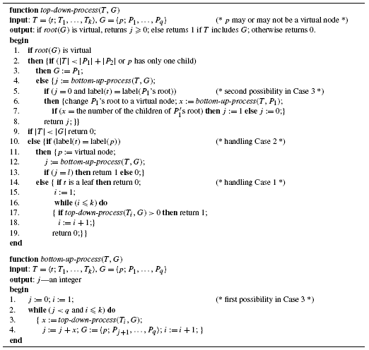
3. Algorithm

Slide 18
4. computational complexities
Proposition 2. Let G(v) = [u₁,u₂, . . . , u_{s}].
Then, u_{i} ≠ u_{j} if i ≠ j and all u_{i} ’s are on a same path.
Proposition 3. The time complexity of the algorithm is
bounded by O(|T| · height(G)).
Proposition 4. The time complexity of the algorithm
with redundancy removing is bounded by O(|T| ·
|leaves(P)|).
During the execution of the algorithm, no data structures are created. Thus, the algorithm needs no extra space.

Slide 19
5. Conclusion
In this paper, a new algorithm for checking the inclusion of a pattern tree P in a target tree T is discussed. The main idea of this is to integrate the topdown searching into a bottom-up computation. The algorithm needs O(|T | · min{D_{P} , |leaves(P)|}) time and no extra space, where D_{P} represents the height of P .

